Slide 1


π
Generative ai vs AI agents vs Agentic AI
July 2025
π

Slide 2
π
AI Agent
Agent
Reasoning &
Decision making
Action
LLM
Tools
AI Agent is LLM Powered system that can independently thick ,decide and take action using external tools or api calls to achieve a goal
LLM
Weds
Tools
Called Agent
LLM are good for reasoning(decision making)
Notes:
Content: https://www.linkedin.com/pulse/chunking-strategies-ai-data-kash-kashyap-0lghe/

Slide 3
π
LLM is Just like human body with only brain but there is not hands and legs.
means it can think and speak but can not perform any task
Just like if we ask how many difference way to we can go from Delhi to Bombay
it can answer
By Flight
By Train
By Bus another way
Ok.If we again ask can you book my ticket
LLM is no answer
Because it odes not have capability to perform any task
It can not call api
it can not tweet on my behalf
it can not connect to db.
means it is human body with only brain that can think and speak but not perform any task
Notes:
Content: https://www.linkedin.com/pulse/chunking-strategies-ai-data-kash-kashyap-0lghe/

Slide 4
π
Generative AI
Generative Al is a type of artificial intelligence that creates new content-such as text, images, or audio, video based on patterns learned from existing data.
at the heart of it ,there is large langauage model and this model can be
GPT4
Claude
GenAI with only LLM
What is price of Air India Flight from New york to Delhi tomorrow?
LLM
i do not know the latest price. My knowledge is cut of till Dec2024
they are trained on huge amount of data and based on that it will be generating the answer
Notes:
Content: https://www.linkedin.com/pulse/chunking-strategies-ai-data-kash-kashyap-0lghe/

Slide 5

π
But You might have noticed if you ask some question to chat GPT,you might be see "searching the web" text and it will do web search and it will return the latest info from the internet
What is price of Air India Flight from New york to Delhi tomorrow?
LLM
the price is 1200$-economy and 3400$ business class
Tool or Hammer, screwdriver
So in this LLM if we give access to Expedia Api or makemytrip api ,then LLM is smart enough to call this api and retrieve price of flight
So this is getting more intelligent than just simple LLM which is trained on some knowledge cutoff
so LLM is like a human brain
Just like you are human you have brain. That will perform very limited number of task, if we give you hammer, screwdriver ,you will be able to do even more.
Notes:
Content: https://www.linkedin.com/pulse/chunking-strategies-ai-data-kash-kashyap-0lghe/

Slide 6
π
later we can also ask book me a cheapest flight tomorrow from A to B.
using Xpedia API,it will first search different flights, then it will decide then chepest one,then it will book the flight
Book me the chepest Air India Flight from New york to Delhi tomorrow?
Flight booked for 1200$-economy and confirmation sent to your email
LLM
1. Searches Flights
2. Decides the cheapest one
3. Book it
Notes:
Content: https://www.linkedin.com/pulse/chunking-strategies-ai-data-kash-kashyap-0lghe/

Slide 7
π
previous you are asking question simple Q$A but now it is actually taking action for you. It is an AI agent
In Simple term, AI Agent is a Program that takes input,
think, decide and take an action to complete a task using tools ,memory and knowledge.
So here some kind of autonomy or independent decision making
Notes:
Content: https://www.linkedin.com/pulse/chunking-strategies-ai-data-kash-kashyap-0lghe/

Slide 8
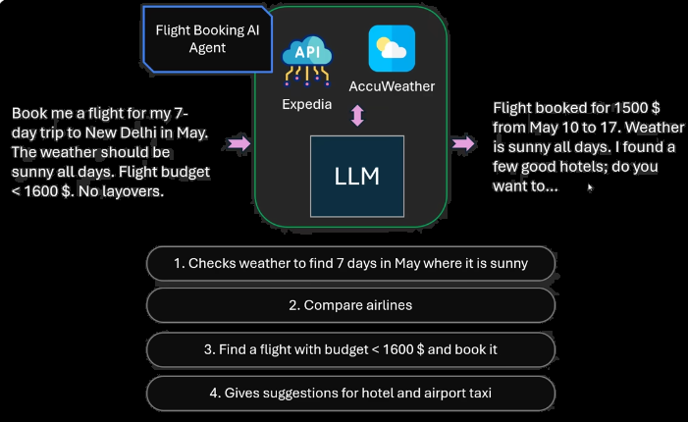
π
This is autonomous but narrow and task specific and doesn't have multiple goal.it
doesn't involve multi step reasoning or planning.
now let ask even more complex question
such as i want to travel new Delhi in may.it is 7 days trip. Weather should be sunny on all the days and flight budget is less than 1600$ and no layover
now this is the king of question that we ask generally to our travel agent and share them the criteria list and ask hey book the best flight in these criteria
So Apparently AI agent can do this
Notes:
Content: https://www.linkedin.com/pulse/chunking-strategies-ai-data-kash-kashyap-0lghe/

Slide 9
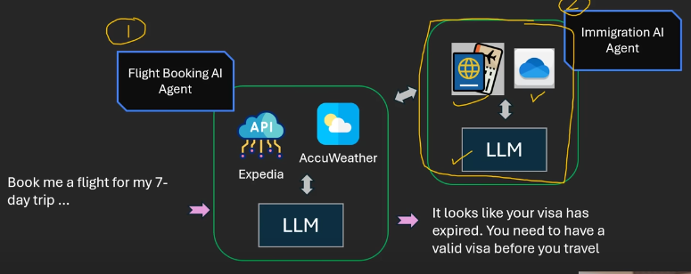
π
we can expand it further because when we travel across countries we might need via .so maybe it can do more complex things such as such as it can call another AI agent which is immigration AI agent and this agent is also powered by LLM but it has access to let's immigration api
So this is a complex system where there is not just one agent but there are two agent. First agent is flight bookin and secons one is immigration AI agent
So the system as a whole if we think about the entire system it ids doing multi step reasoning,multi step planning and working on a complex goal autonomously
Notes:
Content: https://www.linkedin.com/pulse/chunking-strategies-ai-data-kash-kashyap-0lghe/

Slide 10
π
Agentic Al is a system where one or more Al agents work autonomously, generally over long tasks,
making decisions, using tools and even using other agents to reach a goal
Notes:
Content: https://www.linkedin.com/pulse/chunking-strategies-ai-data-kash-kashyap-0lghe/

Slide 11
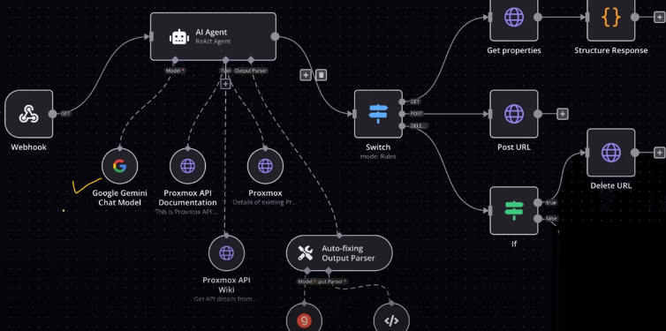
π
Agentic AI generally uses Generative AI as a core component
Notes:
Content: https://www.linkedin.com/pulse/chunking-strategies-ai-data-kash-kashyap-0lghe/

Slide 12
π
Notes:
Content: https://www.linkedin.com/pulse/chunking-strategies-ai-data-kash-kashyap-0lghe/

Slide 13
π
Agentic AI framework
Agno
Crew AI
Langgraph
Microsoft Autogen
Notes:
Content: https://www.linkedin.com/pulse/chunking-strategies-ai-data-kash-kashyap-0lghe/

